Slide 1

Violence Detection System
TERNA ENGINEERING COLLEGE
DEPARTMENT OF COMPUTER ENGINEERING
BE/C-17 Sahil Rane
BE/C-20 Abhishek Mahajan
BE/C-22 Varad Patil
BE/C-40 Priyanshu Nagdeve
Under the guidance of
Guide Name
Prof. Vishwajit Gaikwad
Academic Year
2024-25

Slide 2
Outline:
Abstract
Introduction
Literature Review
Problem Statement
Objectives
Scope
Timeline Chart
Software Development Life Cycle (SDLC)
Software Requirement Specification (SRS)
Project Flow
Risk Management and Mitigation Measures (RMMM)
Performance Metrics
Conclusion
References

Slide 3
Abstract
The world’s average annual fatality rate from human violence is 7.9 per
10,000 people.
Most of this human violence takes place in an isolated area or of sudden.
The information delay here is a major impediment in stopping these acts.
To thrive on this issue, the detection technique is used in this study.
Detecting moving objects from CCTV is one of the most effective computer
vision algorithms.

Slide 4

Introduction
Heightened concerns over safety in public spaces, workplaces, and schools due to increasing incidents of violence.
Violence Detection System leveraging AI, machine learning, and real-time data analysis.
Prompt detection and response to violent behaviors to mitigate risks and ensure safety.
Exploration of advanced technology components and their role in revolutionizing security measures.

Slide 5
Literature Review
Sr. No. | Project Title | Techniques | Strengths | Weaknesses
[1] | Human Violence Detection System using Deep Learning Techniques | Yolo V5, ResNet 50, Inception V3 | The paper demonstrates strong innovation by effectively integrating advanced deep learning models, Inception-v3 and YOLO-v5, to create a robust system for real-time violence detection in video surveillance. This comprehensive approach, combining image classification and object detection, enhances the system's ability to accurately identify violent activities and associated objects like weapons. | The paper states that this system provides moderate accuracy of 74%, which may not be sufficient for critical applications where precision is important. High Definition Videos requires more computational time.
[2] | FTCP: Full Temporal Cross Fusion Network for Violence Detection System | Convolutional neural networks (CNNs) for gesture recognition. Python, OpenCV, TensorFlow | The FTCF network's approach to handling spatiotemporal features can be valuable for enhancing violence detection systems. The high accuracy achieved by the FTCF Net suggests that it is an effective model that could potentially be adapted or used as a baseline in your project. | The limitations could include the need for large computational resources for training the deep learning model and potential challenges in generalizing the model to unseen datasets

Slide 6
20 | Project Title | Techniques | Strengths | Weaknesses
[3] | A survey on deep learning-based real-time crowd anomaly detection for secure distributed video surveillance. | Yolo V5, ResNet 50, Inception V3 | This paper provides valuable insights into the state-of-the-art deep learning techniques for real-time anomaly detection, which can be useful for developing a violence detection system. It discusses the strengths and weaknesses of different approaches and highlights the importance of real-time processing capabilities. | The paper highlights the computational complexity of deep learning models and the need for large datasets to train these models effectively. It also notes the challenge of real-time processing and the difficulty in generalizing models to different environments.
[4] | State-of-the-Art Violence Detection Techniques: A review | Machine Learning, OpenCV, Human Pose Extraction | The effectiveness of different violence detection techniques..Current challenges such as false positives/negatives, real-time processing, and scalability | The limitations could include the need for large computational resources for training the deep learning model and potential challenges in generalizing the model to unseen datasets

Slide 7
Problem Statement
Design an automated violence detection system using YOLO v5, ResNet50, and Inception V3 to accurately detect and classify violent incidents in real-time videos, addressing the limitations of manual monitoring and traditional computer vision techniques, and improving public safety and law enforcement response.

Slide 8
Objective
To develop an advanced, real-time violence detection system leveraging deep learning techniques.
This system integrates the power of YOLOv5 for object detection and localization with the feature extraction capabilities of Inception V3 and ResNet 50.
Aiming to accurately identify and classify violent behaviors in video streams, thereby enhancing public safety and security measures.

Slide 9
Scope
The future scope of the violence detection system includes enhancing model accuracy and reducing false positives through advanced AI techniques, expanding deployment to diverse and large-scale environments, and integrating privacy-preserving methods to address ethical concerns. Additionally, the system could be adapted for real-time response, smart city applications, and extended to detect a broader range of suspicious behaviors.

Slide 10
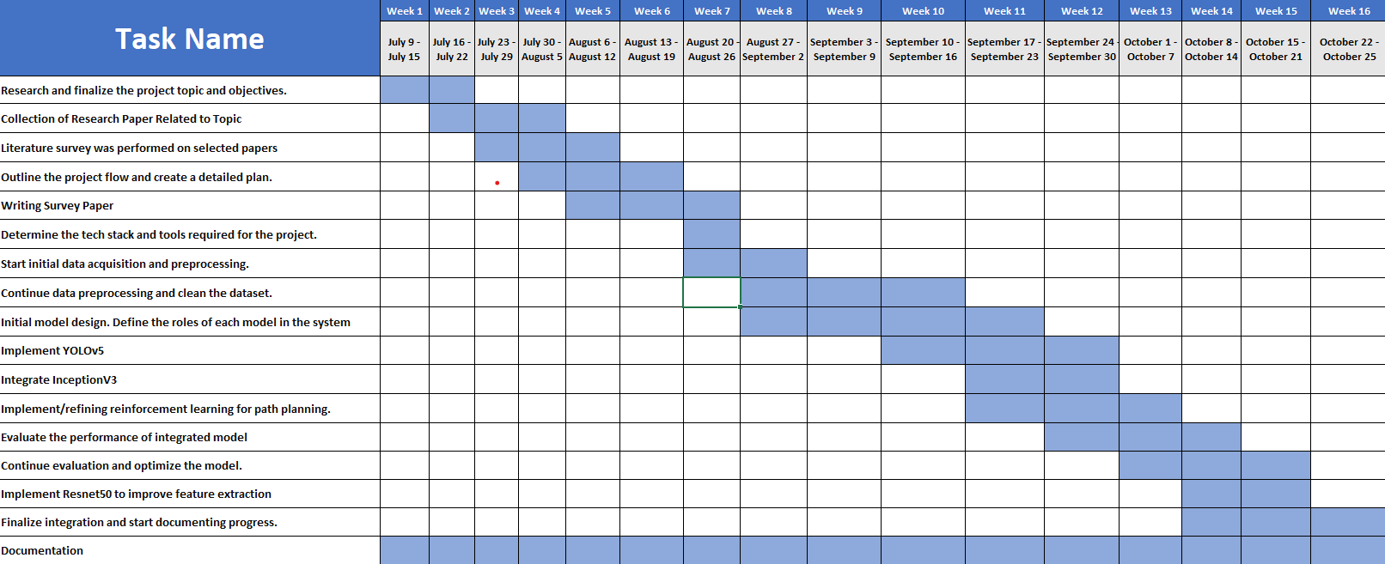
TimeLine Chart

Slide 11
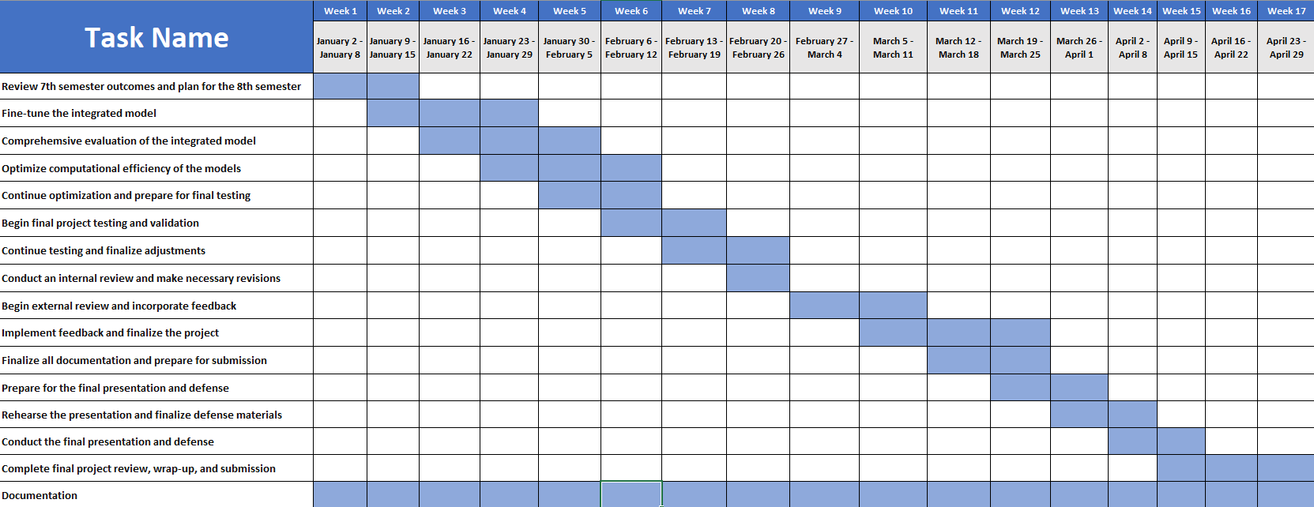

Slide 12
Software Development Life Cycle (SDLC)
Early Delivery
Risk Mitigation
Flexibility
Continuous Testing
User Feedback
Resource Management
Project Control

Slide 13
Software Requirements Specification (SRS)
Functional Requirements:
1. Violence Detection:
2. Video Feed Processing:
3. Object Detection:
4. Alert Generation:
Non-Functional Requirements:
1. Performance:
2. Scalability:
3. Reliability:
4. Security:
5. Usability:
6. Maintainability:

Slide 14
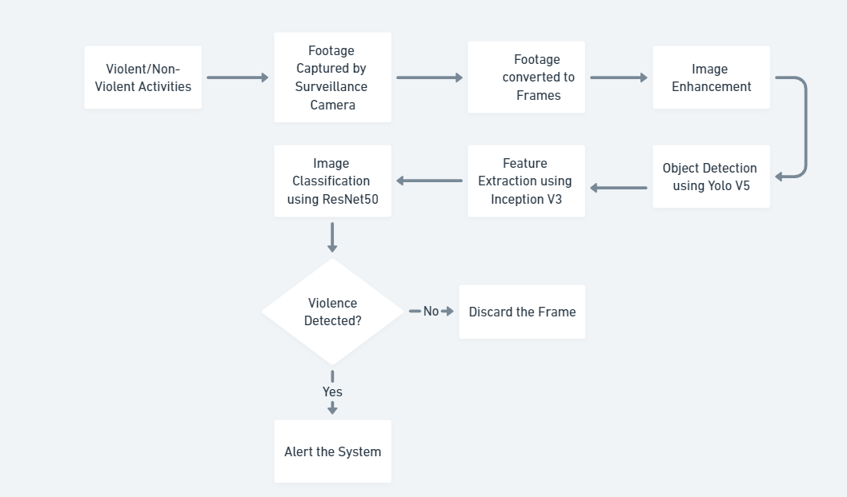
Project Flow

Slide 15
Risk Management and Mitigation Measures (RMMM)
Mitigation Strategies:
1. Data Quality Issues:
- Collect diverse, high-quality training data
- Implement data preprocessing techniques
2. Model Accuracy:
- Fine-tune models for specific use cases
- Regularly evaluate and update models
3. Computational Resources:
- Utilize cloud computing or GPU acceleration
- Optimize model architectures for efficiency
4. Security and Privacy:
- Implement access controls, encryption and ensure compliance with data protection regulations
5. Integration Challenges:
- Use standardized frameworks, APIs
Risks:
Data Quality Issues:
- Poor video quality, inadequate training data
2. Model Accuracy:
- Inaccurate violence detection, false positives/negatives
Computational Resources:
- Insufficient processing power, memory
4. Security and Privacy:
- Unauthorized access, data breaches
Integration Challenges:
- Difficulty integrating YOLO v5, ResNet50, Inception V3

Slide 16
Performance Metrics
Objective Metrics:
Accuracy: Measures the overall correctness of the system in detecting violence
Precision: Measures the proportion of true positives (correctly detected violence) among all positive predictions.
Recall: Measures the proportion of true positives among all actual violent instances.
F1-score: Harmonic mean of precision and recall.
Mean Average Precision (mAP): Measures the average precision across all classes (violent and non-violent).
False Positive Rate (FPR): Measures the proportion of false positives (incorrectly detected violence) among all negative instances.
False Negative Rate (FNR): Measures the proportion of false negatives (missed violence) among all positive instances.
Detection Rate: Measures the proportion of correctly detected violent instances among all instances..

Slide 17
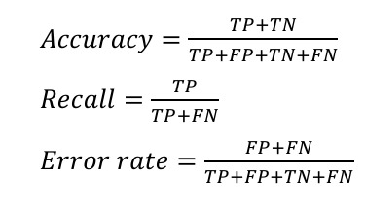
Performance Metrics
Subjective Metric:
User Satisfaction: Measures how satisfied users are with the system's performance.
User Trust: Measures how much users trust the system's decisions.
Perceived Accuracy: Measures how accurate users perceive the system to be
Perceived Reliability: Measures how reliable users perceive the system to be.
User Engagement: Measures how engaged users are with the system.
User Experience: Measures the overall user experience with the system.
Content Creator Satisfaction: Measures how satisfied content creators are with the system's performance.
Content Creator Trust: Measures how much content creators trust the system's decisions.

Slide 18
Current State
Current State:
We have finished with
Literature Review for our
report and also have studied
related papers in depth to learn
the new technologies which can
be used in our project. We are
done with the survey papers and
we are about to publish the
survey paper by the end of the
term.
Pending:
Technical Parts like coding and testing are not yet completed because we are still learning new technologies.
Report of the project is in progress.

Slide 19

Conclusion
With the rapid growth of surveillance cameras in different fields of life to monitor the human activity, there is a massive growth in the demand of such system which recognize the violent events automatically.
Accuracy is depending upon the techniques of object recognition, features extraction and classification along with dataset being used.
Our study potentially contributes in highlighting the techniques and methods of violence activity detection from surveillance videos.

Slide 20
References
[1] State-of-the-art violence detection techniques in video surveillance se curity systems: a systematic reviewState-of-the-art violence detection techniques in video surveillance security systems: a systematic re view0,[PeerJ Computer Science],2022.
[2] Human Violence Detection Using Deep Learning Techniques,2022 J. Phys.: Conf.
[3] Violence 4D: Violence detection in surveillance using 4D convolutional neural networks,[IET Computer Vision]Volume 17,2023.
[4] Human skeletons and change detection for efficient violence detection in surveillance videos[Computer Vision and Image Understanding],Volume 233, 2023.
[5] A survey on deep learning-based real-time crowd anomaly detection for secure distributed video surveillance[Personal and Ubiquitous Comput ing.],June,2021.
[6] FTCF: Full Temporal Cross Fusion Network for Violence Detection in Videos[Applied Intelligence],Volume 53, Pages 4218-4230, Year 2023.
[7] Toward Fast and Accurate Violence Detection for Automated Video Surveillance Applications[IEEE Access],Volume 11, 2023.

Slide 21
Thank you

